Slide 1
Build Your Portfolio
Notes:
Welcome to Build Your Portfolio.

Slide 2
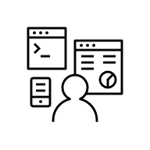
What you will learn
Identify the importance of a portfolio
Explain how to build a portfolio
List projects to add to your portfolio
Notes:
After watching this video, you will be able to:
<click 1> Identify the importance of a portfolio
<click 2> Explain how to build a portfolio
<click 3> List projects to add to your portfolio

Slide 3
Courses and degrees
Courses can equip you with job-oriented skills
A professional portfolio can highlight your skills effectively
Notes:
<click 1> Study can help you in getting a job, but you will have to put in some work as well. ​Many courses will equip you with job-oriented skills, and you can certainly use their certificates to enrich your resume. You can also display your knowledge during an interview. ​
<click 2> However, a professional portfolio is an effective tool to highlight your skills and demonstrate your ability to grow, and an employer can take time to examine it carefully.

Slide 4
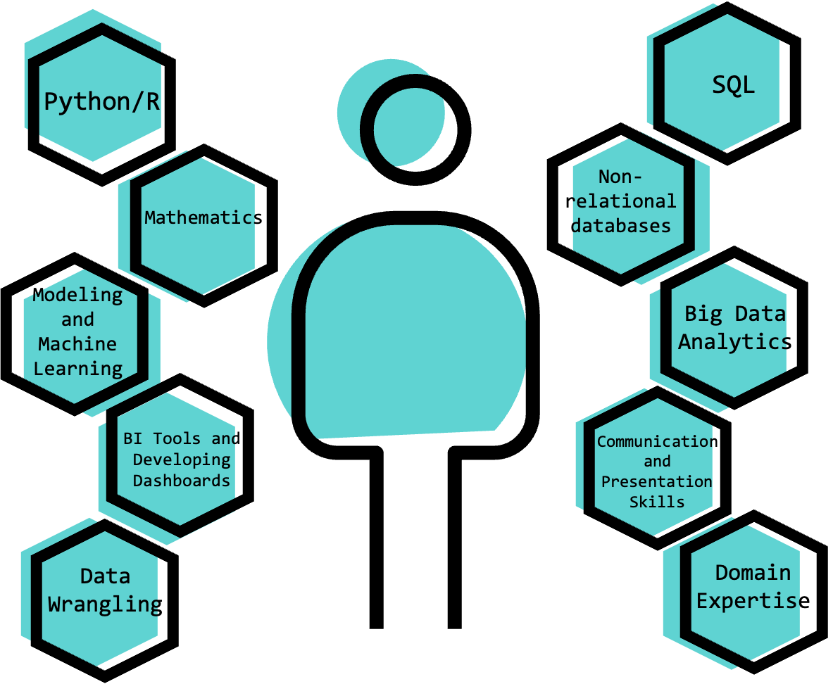
What are employers looking for?
Final degree project
Research papers
Freelance experience
Internship experience
Project using real-world data sets
Notes:
Employers often look for a range of skills including technical abilities, communication skills, and an understanding of good business practices, as well as an understanding of the domain of the industry. All of these can be demonstrated in a portfolio. Examples of relevant previous work might include:
<click 1> If you have enrolled in a degree program, you can add your research or a capstone project to your portfolio.
<click 2> Many people work as freelancers to gain experience, and if you have permission, you can include freelance work.
<click 3> Any experience and projects that you have worked on as an intern may be worth including.
<click 4> As you acquire additional data science skills, you should try to work on compelling and increasingly complex projects. If you have worked or interned somewhere and worked on a product that is now launched, mention you have worked on it and include a link if possible. You can also look at the job descriptions that you’re targeting, pull out the key skills that they require, and build projects around those skills.

Slide 5
Ideas for adding to the portfolio
1st
BLOG
BLOG
Replicating research
Competitions
Blogs and vlogs
Hobby projects
Notes:
Here are some more ideas for creating portfolio content.
<click 1> When you want to understand something on a deeper level, building on the success of predecessors is always a great idea. One example might be coding a neural network from scratch using a research paper. This shows your ability to understand the benefit of research papers and the ability to code your own algorithm without using a predefined library.
<click 2> There are many data challenges hosted by Kaggle, Hacker rank, Leet code, and so on. These competitions are normally focused on real-world problems. Participating and documenting them in your portfolio can be promising if you rank high in the competition.
<click 3> If you create content in the form of a blog or vlog, you should include links to it. This is a terrific way to demonstrate soft skills as well as displaying your technical knowledge and your ability to share with other professionals.
<click 4> You can include course projects or hobby projects in your portfolio by adding a few more details and features. For example, include error logging and handling if the project doesn’t have it.

Slide 6
Create new portfolio projects
How to plan a strong project:
Check job listings to find out which skills are in demand
Generate project ideas that use those skills
Always choose real-world data sets for your projects
Clean and analyze your data set
Notes:
Here are four steps that can help you build a strong portfolio by creating some new projects:
<click 1> To build a portfolio for the job you want, start by understanding which skills you will need to demonstrate. Studying current listings will typically show you which skills are best to highlight in your portfolio projects.
<click 2> When generating your own project ideas or trying to use business problems, think about methodologies that can be used to solve the business problems and identify resources that could be used in solving the problem. You can also and learn from other people’s projects by visiting data science communities.
<click 3> When you have decided on an idea for your project, you will need data. You’ll want to show practical experience, so use a real-world data set, since real data sets are messy and you will need to do some cleaning. Check online repositories that offer access to public data, such as Data.gov, Reddit Datasets, GitHub’s Awesome Data, and Google Dataset Search.
<click 4> After you have chosen a research question and datasets that can be used to address the problem, you can perform exploratory data analysis to understand the data and the type of transformations that need to be performed. When you have cleaned and transformed the data, you can start applying machine learning models to solve the problem.

Slide 7
Use GitHub effectively
Tips for leveraging GitHub:
Use basic HTML templates to make the code look professional
Update the project frequently
Make contributions to other users' projects and allow them to contribute to your projects
Use GitHub to show new and less-used skills
Include a README file
Notes:
It’s smart to have several projects that display the breadth of your skills and interests hosted on GitHub. GitHub is accessible and familiar to most professionals in technical fields, and it allows others to see your projects in real time and in a real hosting environment.
<click 1> Here are some tips to help you use GitHub to best advantage.
<click 2> Deploy your code on GitHub pages and use basic HTML templates to make the code look professional.
<click 3> Update the project frequently – it’s better to make small changes often and post them.
<click 4> Make contributions to other users' projects to maintain a strong profile and allow them to contribute to your projects.
<click 5> Experiment with latest technologies and create simple projects around them. Also, use GitHub projects to showcase skills that are less used in your primary work.
<click 6> Don’t forget to include a README file with a description of your project, to show you know how to communicate results.

Slide 8
Recap
In this video, you learned:
A portfolio is an excellent way to showcase your work and skills directly
There are many types of work that you can include in your portfolio
You can build new projects to make your portfolio stronger
It’s helpful to use GitHub thoughtfully
Notes:
In this video, you learned:
<click 1> A portfolio is an excellent way to showcase your work and skills directly, because employers value what they can see in your portfolio and how it reflects what you can do,
<click 2> There are many types of work that you can include in your portfolio to good effect,
<click 3> You can build new projects to make your portfolio stronger.
<click 4> And it’s helpful to use GitHub thoughtfully
Having a strong resume is primary for job seekers, but there is more than one way to show off your skills. A portfolio can show what you can do in a practical, hands-on way. It is important to emphasize that keeping a portfolio is an iterative process. As your knowledge grows, your portfolio should be updated.

